Slide 1
Obesity Levels
A project aimed at studying varying obesity levels among a population sample with different lifestyle choices.

Slide 2
Introduction
Obesity is a medical condition defined as having excess amounts of body fat.
Obesity is associated with other health conditions such as heart disease, diabetes, hypertension and certain types of cancers.
Obesity is largely a lifestyle condition with diet, physical activity and exercise choices playing a major role in contributing to the surging cases of obesity.

Slide 3
Dataset Details
This dataset include data for the estimation of obesity levels in individuals from the countries of Mexico, Peru and Colombia, based on their eating habits and physical condition.
The data contains 17 attributes and 2111 records, the records are labeled with the class variable NObesity (Obesity Level), that allows classification of the data using the values of Insufficient Weight
Normal Weight,
Overweight Level I
Overweight Level II
Obesity Type I
Obesity Type II
Obesity Type III

Slide 4
Dataset details cont..
77% of the data was generated synthetically using the Weka tool and the SMOTE filter, 23% of the data was collected directly from users through a web platform.

Slide 5
Dataset Source
Fabio Mendoza Palechor, Alexis de la Hoz Manotas, Dataset for estimation of obesity levels based on eating habits and physical condition in individuals from Colombia, Peru and Mexico, Data in Brief, Volume 25, 2019, 104344, ISSN 2352-3409, https://doi.org/10.1016/j.dib.2019.104344. (https://www.sciencedirect.com/science/article/pii/S2352340919306985)
https://archive.ics.uci.edu/ml/datasets/Estimation+of+obesity+levels+based+on+eating+habits+and+physical+condition+

Slide 6
Column Description
Age: Age of respondents in years
Height: Height measured in meters
Weight: Weight measured in kgs
Family history: Family history of having obesity
FAVC: Frequency of consumption of high caloric food
FVCV: Frequency of consumption of vegetables
NCP: Number of main meals
CAEC: Consumption of food between meals (snacking)
SMOKE: Whether the respondent is a smoker
CH20: Daily water consumption
SCC: Monitoring of calories consumption
FAF: Physical Activity Frequency
TUE: Time Using Technological Devices
CALC: Alcohol Consumption
MTRANS: Means of transport commonly used by respondent
NOObesity: level of obesity(1-4)

Slide 7
Project Deliverables
create a model for prediction of level of obesity in an individual

Slide 8
Library Imports
import pandas as pd
import numpy as np
import seaborn as sns
import matplotlib.pyplot as plt
from sklearn import preprocessing
from sklearn.feature_selection import SelectKBest, f_classif
from sklearn.model_selection import train_test_split
from sklearn.discriminant_analysis import LinearDiscriminantAnalysis as LDA
from sklearn.ensemble import RandomForestClassifier
from sklearn.linear_model import LogisticRegression
from sklearn.neighbors import KNeighborsClassifier
from sklearn.tree import DecisionTreeClassifier
from sklearn.svm import SVC
from sklearn.metrics import classification_report, accuracy_score, precision_score, recall_score,f1_score
from sklearn.model_selection import GridSearchCV
from sklearn.metrics import confusion_matrix
import pickle
import warnings

Slide 9
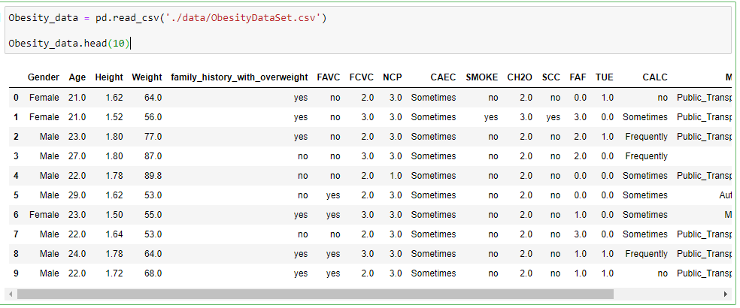
Snippet of dataframe

Slide 10
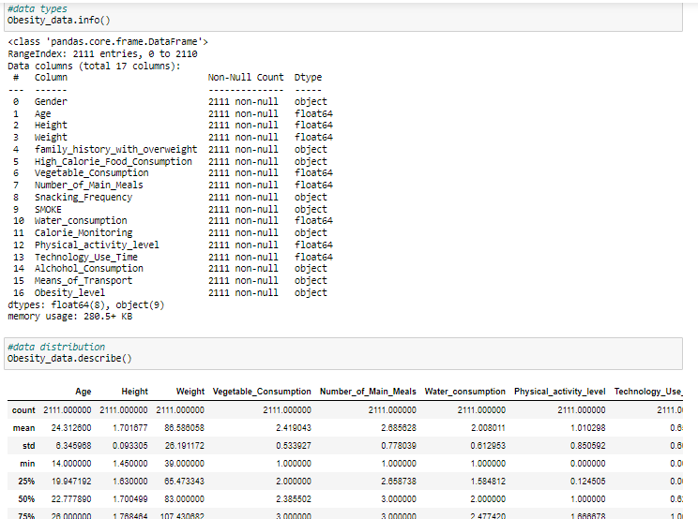
EDA

Slide 11
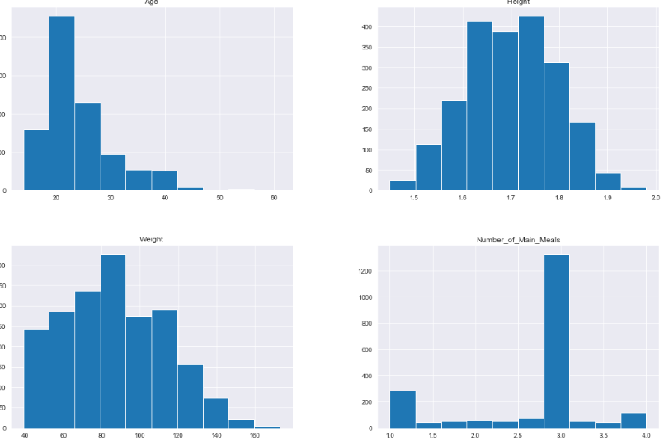
Numerical Column analysis

Slide 12
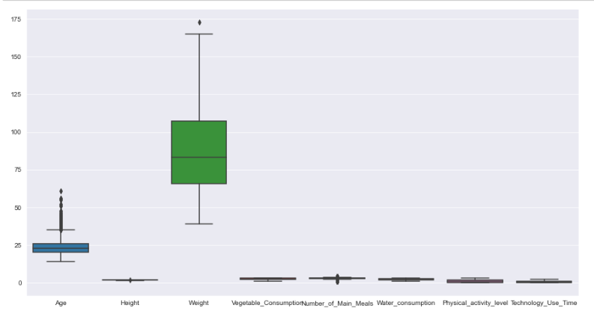

Slide 13
Observations on results
The database contains 2111 instances
There are no missing values in the dataset
The dataset has 8 numerical features.
Number of meals has both the upper and lower outliers
Age, weight, height has outliers on its upper side
A large percentage of people have an average of 3 meals per day
Height, Age and Weight are to a large degree normally distributed while Number of meals experiences skewness

Slide 14
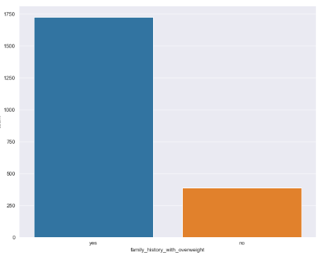
Categorical Column Analysis family history with obesity

Slide 15
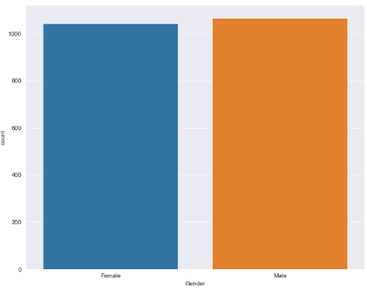
Categorical Column Analysis Gender

Slide 16
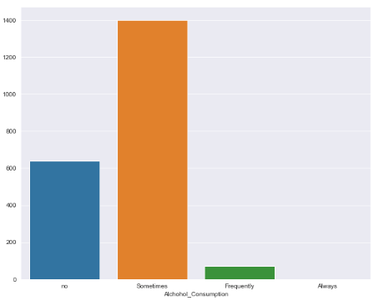
Categorical Column Analysis frequency of alcohol consumption

Slide 17
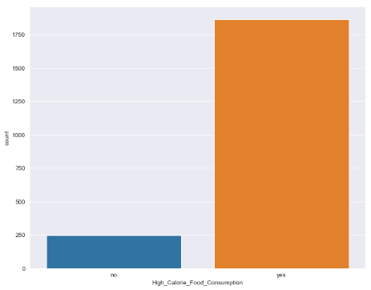
Categorical Column Analysis high calorie consumption

Slide 18
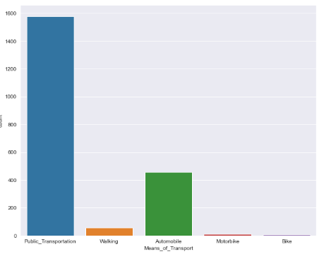
Categorical Column Analysis Means of transportation

Slide 19
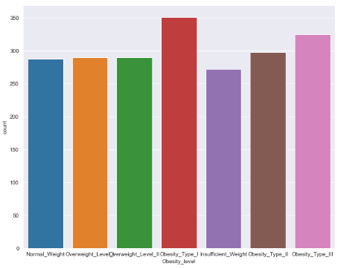
Categorical Column Analysis Weight Distribution

Slide 20
Observation on results
There is fairly equal representation of both genders in the study
Most respondents have a family history with being overweight
Most respondents have high colorie food intake
The snacking,Means of Transport and Alchohol consumption columns have outliers that will be handled through rare levels method
Most of the people in the study are none smokers

Slide 21
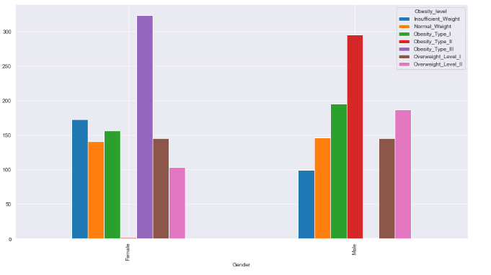
Obesity levels among demographics Gender

Slide 22
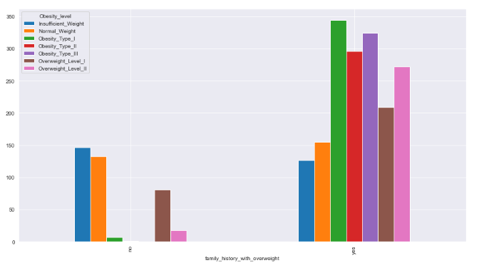
Obesity levels among demographics family hisitory with obesity

Slide 23
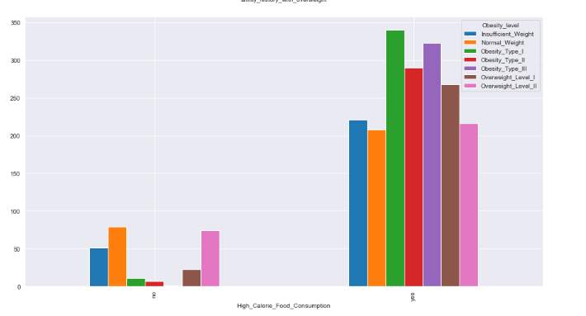
Obesity levels among demographics calorie consumption

Slide 24
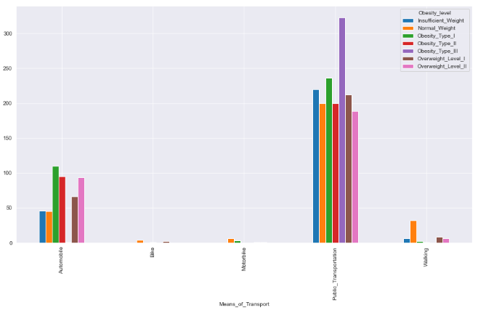
Obesity levels among demographics Means of transport

Slide 25
Observation on results
The most common type of obesity is type 1 followed closely by type 3
The most common form of obesity among the female population was type 3 while in the male population was type2
Most People with a family history of being overweight tend to be obese as well
There is a high correlation of high calorie food intake with all levels of obesity
People who had consumed food in between meals (snacking) frequently were observed to have insufficient weight as compared to the demographic who snacked sometimes that were mostly obese
Smoking was not a very strong factor affecting obesity and overweight levels in the study
Majority of the respondents did not monitor their calories
The preferred means of Transport among the population was public transport

Slide 26
Preprocessing
Handling of Outliers using z-score method

Slide 27
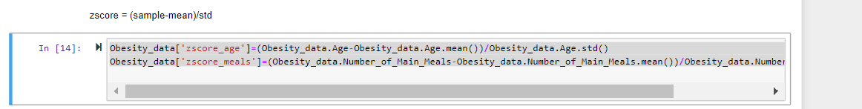
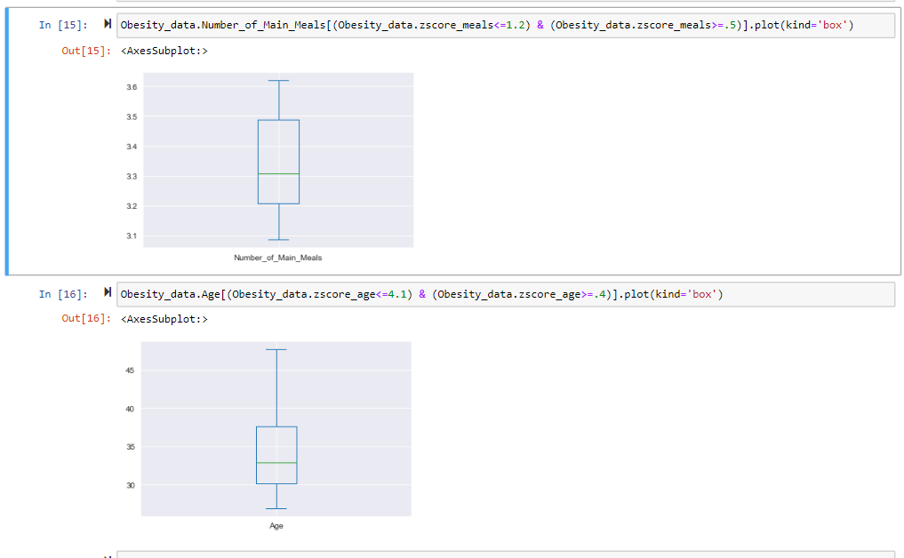

Slide 28
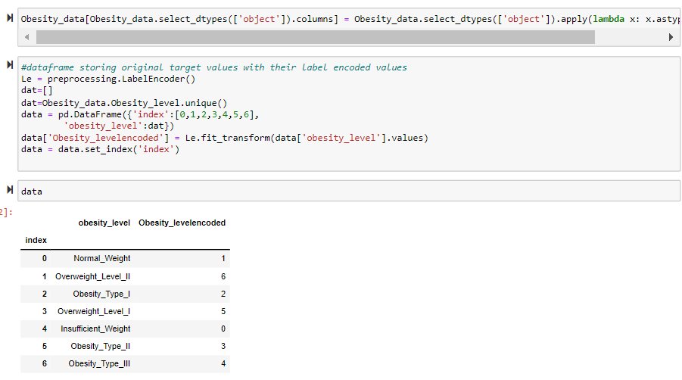
Categorical data encoding

Slide 29
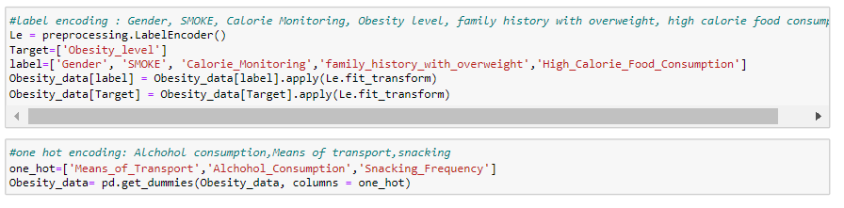
Categorical data encoding cont..

Slide 30
Feature engineering
BMI
A measure of weight divided by the square of the samples height
BMI = weight/(height)^2

Slide 31
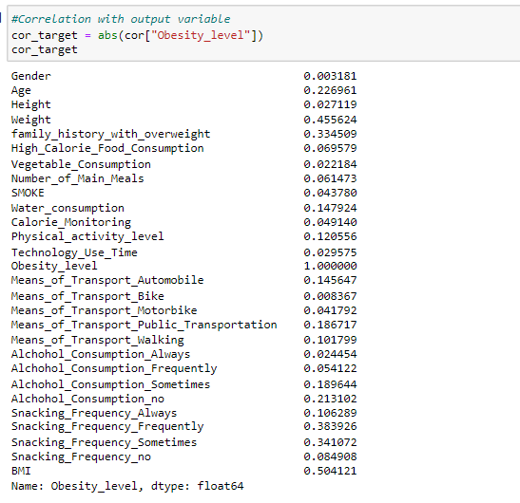
Check for correlation

Slide 32
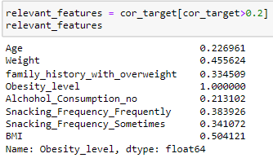
Relevant features

Slide 33
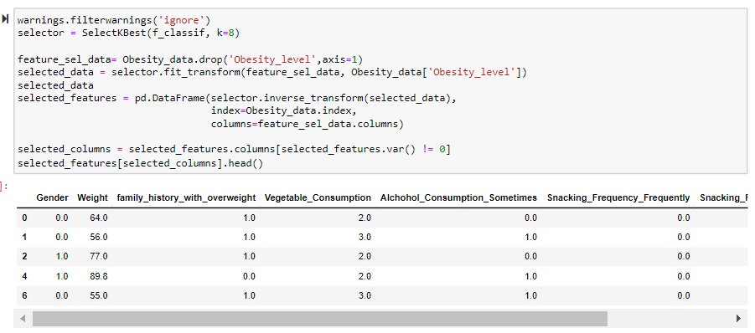
Feature selection using sklearn

Slide 34
Features to select
Using sklearn to perform feature selection has yielded the following features as best to use for model creation
Gender
Weight
Family history with overweight
Vegetable consumption
Alcohol consumption sometimes
snacking frequency (sometimes & Frequently)
BMI

Slide 35
Test-Train split ratio 80:20

Slide 36
Model Creation
The project is a classification problem, thus various classification models were used including
Logistic
SVC
K Nearest Neighbors
Random Forest
Decision Tree
LDA

Slide 37
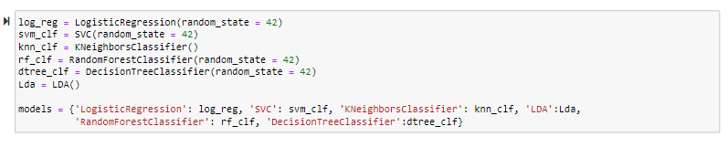
Model Creation

Slide 38
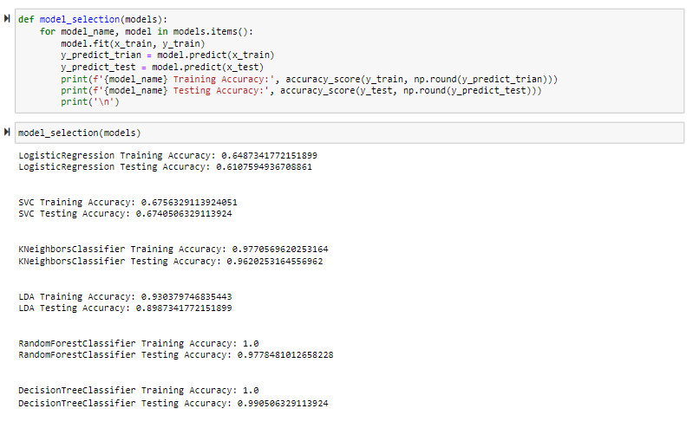
Model Selection

Slide 39
Model Selection cont..
From the results K Nearest Neighbors is the best model
It has very little error of accuracy between training data and testing data

Slide 40
Hyper parameter tuning
With KNN as the preferred choice hyper parameter tuning is done
Some of the hyper parameters include
N neighbors
Weights
metrics

Slide 41
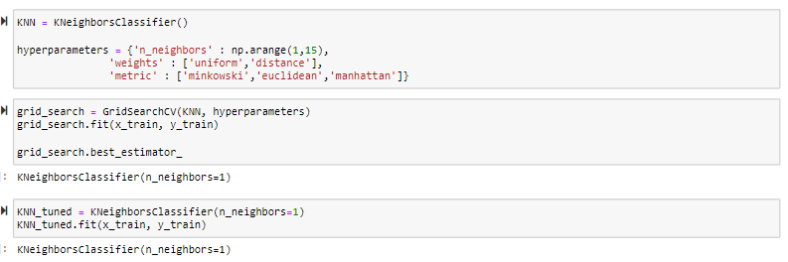
Results
The hyper parameter chosen for optimal results is a KNN classifier with 1
N-neighbours

Slide 42
Model Evaluation
Evaluation was done using different methods including
Confusion matrix
Precision – recall

Slide 43
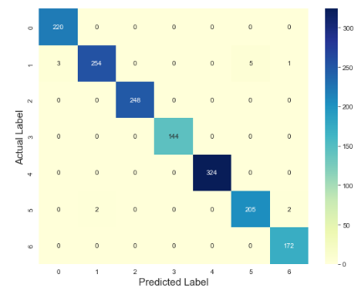
Confusion matrix

Slide 44
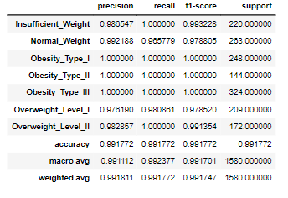
Precision-Recall

Slide 45
Conclusions
Gender
Weight
family_history_with_overweight
Vegetable_Consumption
Alchohol_Consumption_Sometimes
Snacking_Frequency_Frequently
Snacking_Frequency_Sometimes
BMI are the most important factors in identifying persons who are at risk of having obesity and overweight complications.
Other variables hold less significance while evaluating the model.

